Slide 1

System Performance
Computer System Engineering, Fall 2018. (IPADS, SJTU)
Policies in caching and scheduling
Yubin Xia

Slide 2
Improving Performance
Get faster hardware
Fix application: better algorithm, fewer features (not in CSE)
General system optimization techniques:
Batching
Caching
Concurrency
Scheduling
Application
System
Hardware

Slide 3
Cache Policies
Multi-level Memory

Slide 4
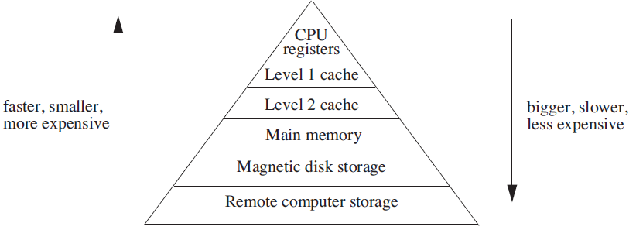
Analyzing Multilevel Memory Systems
Only consider the adjacent pair of levels
View it as a two-level multilevel memory system
The 1st is primary device, the 2nd is secondary device

Slide 5
Locality of Reference and Working Sets
In many situations most memory references are to a small set of addresses for significant periods of time
As the application progresses, the area of concentration of access shifts, but its size still typically remains small
Called "locality of reference"
Temporal locality and spatial locality
Thrashing: repeated movement of data back and forth between two levels

Slide 6
Multilevel Memory Management Policies
Each level of multi-level memory system can be characterized by 4 items
The string of references directed to that level
The bring-in policy for that level
The removal policy for that level
The capacity of the level

Slide 7
Page-removal Policies
First-in, first-out (FIFO) page-removal policy
Remove the page that has been in the primary device the longest
Belady's anomaly
Performance drops with a larger primary device capacity!
Optimal (OPT) page-removal policy
Choose for removal the page that will not be needed for the longest time
Least-recently-used (LRU) page-removal policy
The page in the primary device that has not been used for the longest time

Slide 8
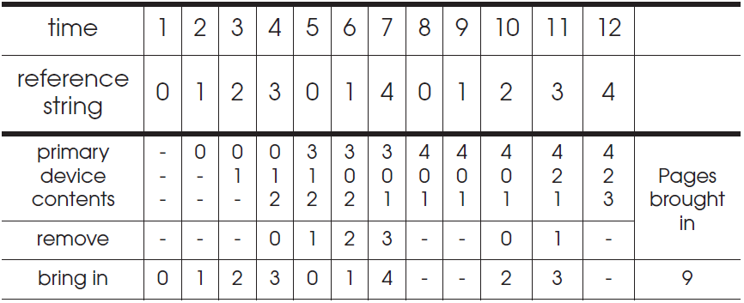
First-in, First-out (FIFO) Page-Removal Policy
The page for removal is the one that has been in the primary device the longest

Slide 9
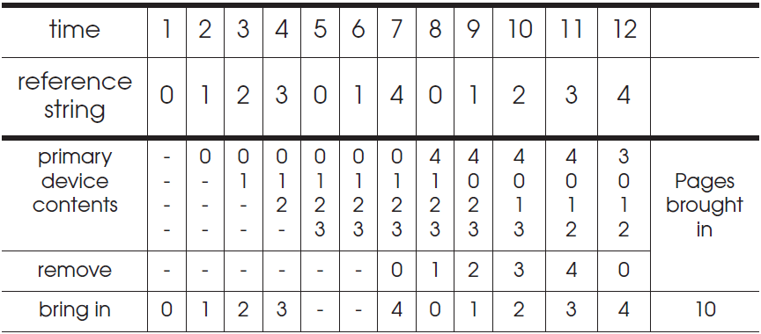
Belady's Anomaly
Increase of missing-page exception numbers with a larger primary device capacity

Slide 10
Stack Algorithms
Subset property
For the optimal policy, at all times, the pages it keeps in the 3-page memory is a subset of that it keeps in the 4-page memory
No Belady's anomaly if subset property holds
At all times and for every possible capacity of primary device, it creates a total ordering for pages at a given time

Slide 11
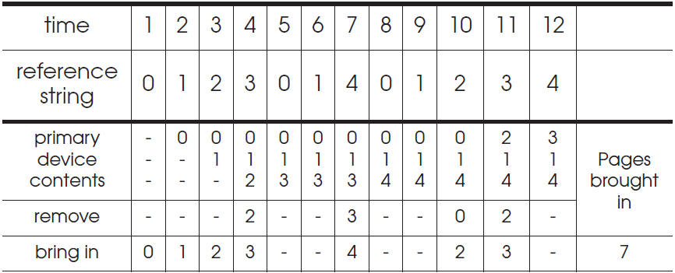
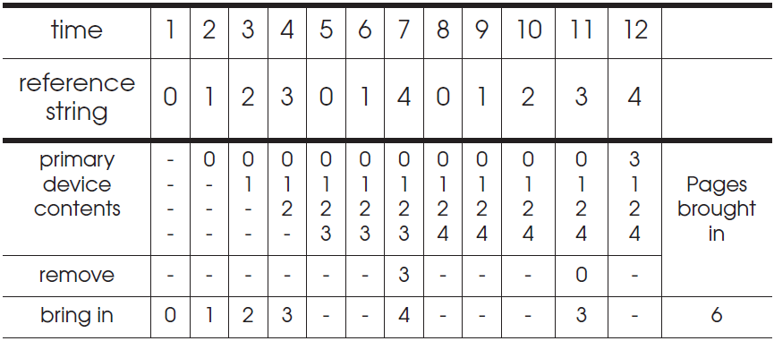
OPT (Optimal) Page-Removal Policy
Always choose for removal the page that will not be needed for the longest time

Slide 12
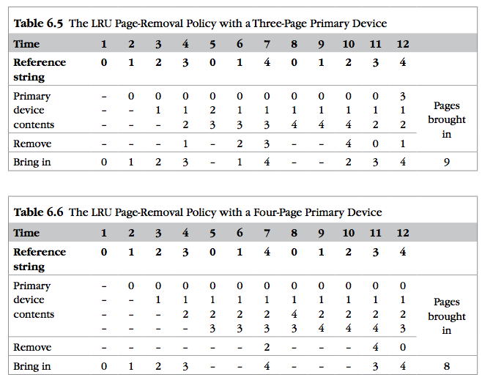
LRU
It is confirmed as an error, in errata part I.
Notes:
It is confirmed as an error, in errata part I.

Slide 13

Least-recently-used (LRU) Page Removal Policy
A program that runs from top to bottom
the virtual memory that is larger than primary device
LRU: always evicts exactly the wrong page
Most-recently-used (MRU) page-removal policy

Slide 14
Comparative Analysis of Different Policies
Ways of deciding the following two things:
How large the primary memory device should be?
Which page removal policy to use?
Collecting traces of the reference strings of typical programs
Simulate the multilevel memory manager with:
Different configurations - Size of primary device
Page removal policy - Traces of memory access

Slide 15
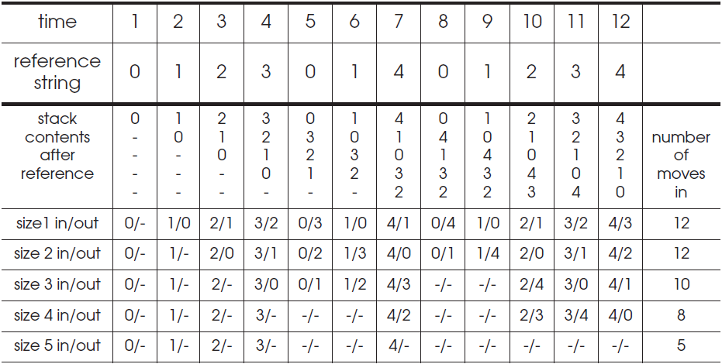
Stack Algorithms for LRU
It can perform a simulation for all possible primary memory size with a single pass through a given reference string

Slide 16
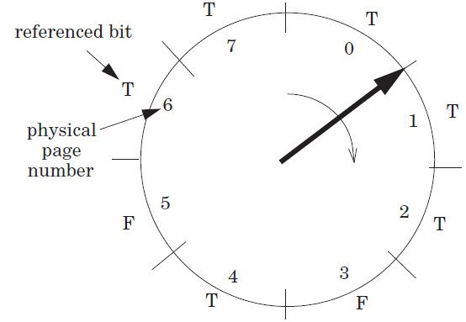
Efficiency of Page-Removal Policies
Clock page-removal algorithm
Base on a hardware setting bit
Reference bit
Move clockwise
If T, set F
Choose as the victim otherwise
Random removal policy
For TLB
Directed mapping

Slide 17
Scheduling

Slide 18
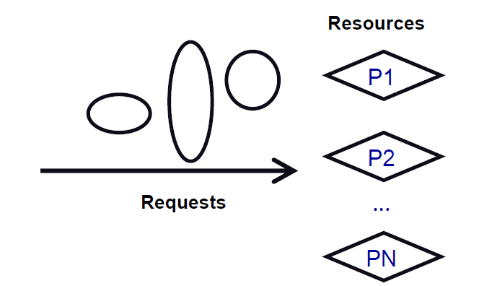
Scheduling
Algorithm that assigns requests to resources
Processor time – Threads
Physical memory – Address spaces
Printers – Printer jobs
Disks – Disk requests
Networks – Packets
Memory bus – Memory requests

Slide 19
Challenges of Scheduling
Easy, if number of requests ≤ resources
Difficulty: Lack of information
Packet scheduling and streaming media
Difficulty: Lack of mechanism to enforce policies
Give high priority to CPU, but can't get to disk or network
Difficulty: Getting mechanism right
Many schedulers break rather than gracefully degrade under load

Slide 20
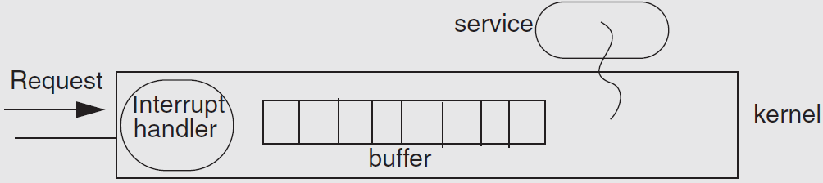
Example: Livelock under Overload
Web news server overloaded
Most of the time is spend to handle interrupt and drop requests
No progress at all!

Slide 21
The Ideal Scheduler
Mini latency: How long a service takes? E.g., Move mouse, cursor moves
Max throughput: Max jobs / time. E.g., Web server pages/second
Low overheads: Scheduler doesn't use any resources
Fairness: everyone gets to make progress, no one starves
Scales linearly up to capacity: Graceful handling of overload
System-level goal may conflict with the needs of individual threads
System: minimal preemption
Apps: finish as soon as possible

Slide 22
Measuring the Request's Response
Turn-around time: The length of time from when a request arrives at a service until it completes
Response time: The length of time from when a request arrives at a service until it starts producing output
Waiting time: The length of time from when a request arrives at a service until the service starts processing the request

Slide 23
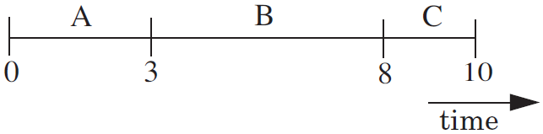
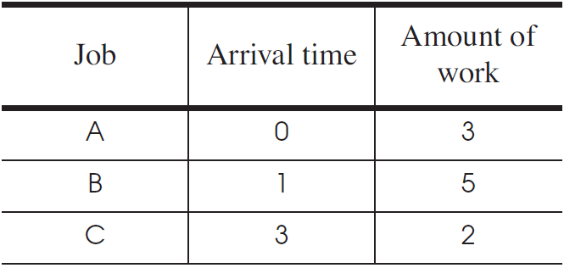
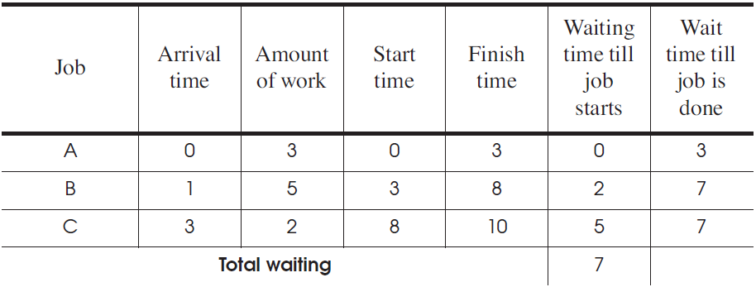
First Come First Server (FCFS)
Fairness paramount
Good for printer scheduler

Slide 24
First Come First Server (FCFS)
For the processor
One thread that periodically waits for I/O but mostly computes
Several threads that perform mostly I/O operations
For the scheduler
It runs the I/O-bound threads first
Then runs the computation intensive thread
All quickly finished computations and waiting for I/O

Slide 25

Convoy Effect
When I/O devices are idle
The I/O-bound threads will quickly finish computations and start I/O
The processor-bound thread will run for a long time
I/O-bound operations will finish I/O and queuing for computation
All the I/O devices will become idle!
When processor is idle
The processor-bound thread finishes computation and starts I/O
The I/O-bound threads will quickly finish computations and start I/O
Processor will become idle!
CPU
Device

Slide 26
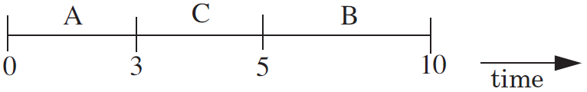
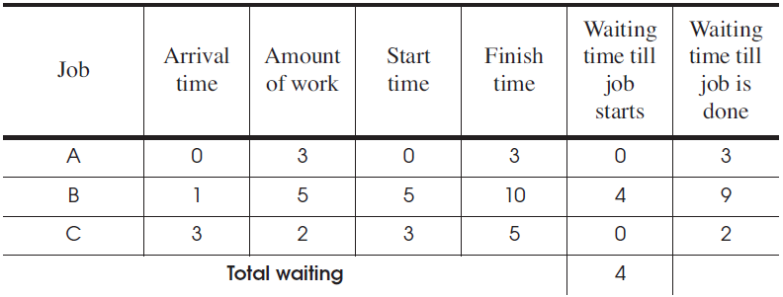
Shortest-Job-First
Chooses the job that has the shortest expected run time
Require a prediction of the running time of a job before running
Starvation: several short jobs makes a long job starve

Slide 27
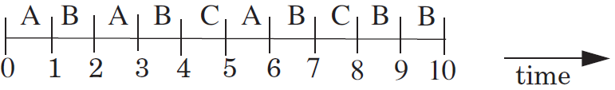
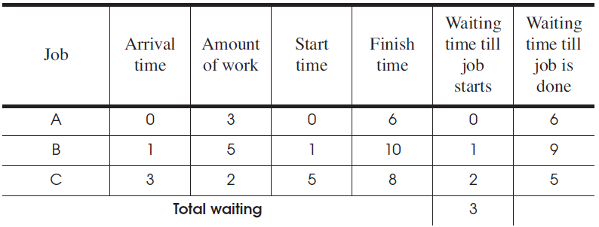
Round-Robin
Select the first job from queue as in the first-come first-serve policy
Stop the job after some period of time, and select a new job

Slide 28
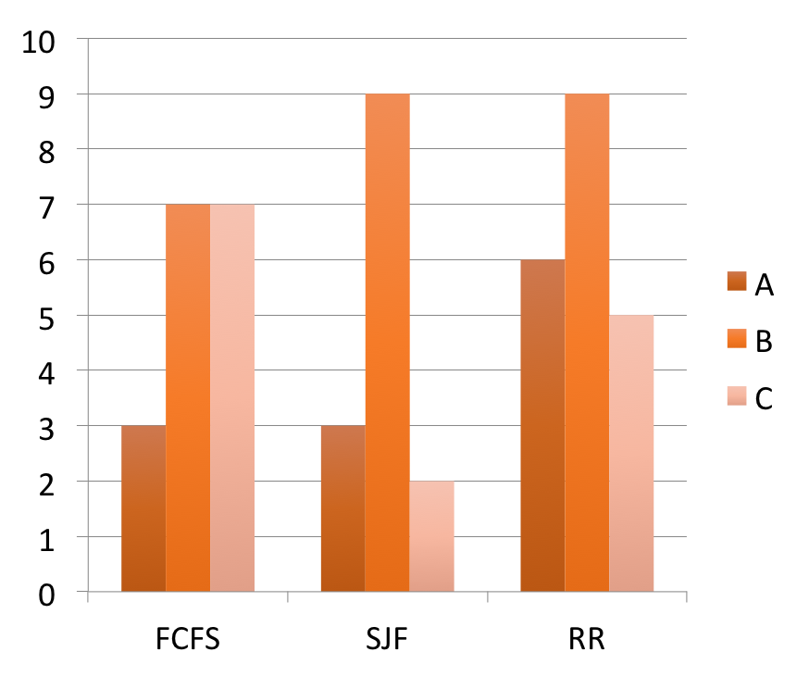
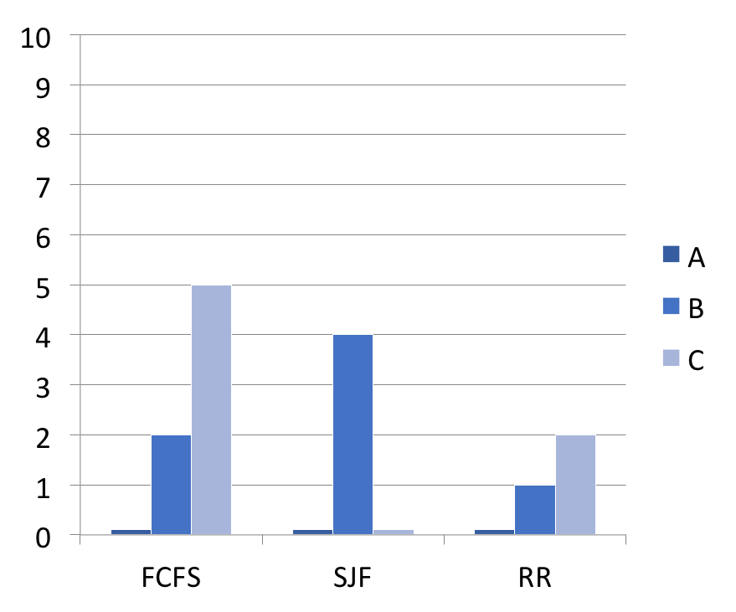
Comparing the Three Policies
Wait time before start
Wait time till done
Amount of work: A:3, B:5, C:2

Slide 29
Priority Scheduling Policy
Priority Scheduling Policy
Assign each job a priority number (static vs. dynamic)
Select the job with the highest priority number
Must have some rule to break ties
Modern CPU schedulers have
Priorities: Run job with the highest priority
Round Robin: Alternate among jobs of same priority, preempt a job if it holds CPU too long

Slide 30
CPU Scheduling Policy
Assign priorities to jobs
Give high priorities to I/O-bound jobs
Give low priorities to CPU-bound jobs
Handles I/O-bound and CPU-bound jobs nicely

Slide 31
CPU Scheduling Policy
Challenge: distinguish I/O-bound and CPU-bound
Look at past behavior to predict the future
Linux: Priority of job is function of amount of CPU it has used
Counterintuitive:
More CPU a job uses/needs, the lower its priority
The less CPU it uses, the higher its priority
Avoids starvation problems: Not running gives task a higher priority

Slide 32
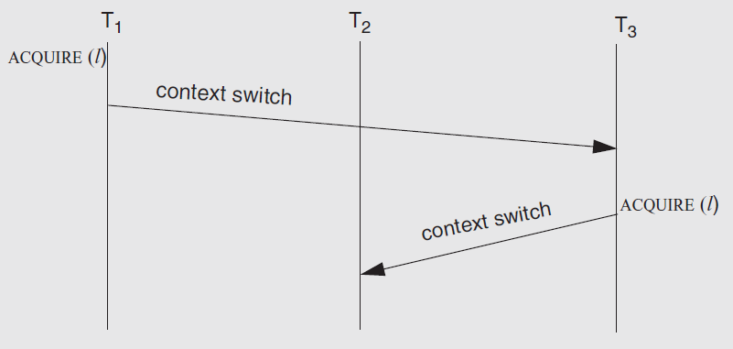
The Priority Inversion Problem
Problem: what if a high priority thread waits for a low priority one which holding a lock?
Solution: priority inheritance

Slide 33
Real-Time Scheduling
Missed deadline = incorrect behavior
Soft real time: Display video frame every 30th of sec
Hard real time: "apply-breaks" process in your car
Scheduling more than one thing: memory, network bandwidth, CPU all at once

Slide 34
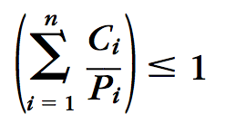
Earliest Deadline First (EDF)
Keep the queue of jobs sorted by deadline
Run the first of the queue
Minimize the total lateness of all the jobs
How to know deadline?
Specified by tasks themselves
In the form of (C, P), C for second, P for period
The scheduler rejects new tasks if sum(Ci/Pi) > 1

Slide 35
Disk Scheduling: Goals
Minimize time spent waiting on disk mechanisms
Moving the disk arm
Waiting for sector to rotate under disk heads
Fairness
Should not make requests wait too long

Slide 36
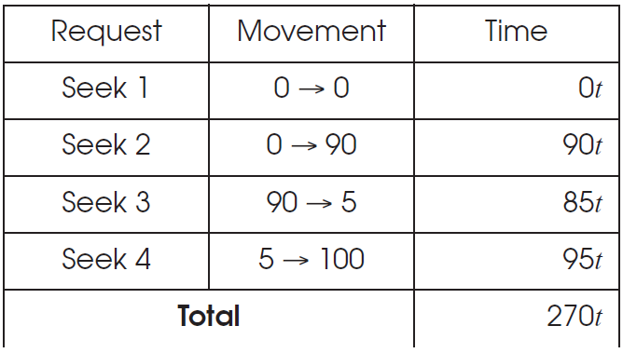
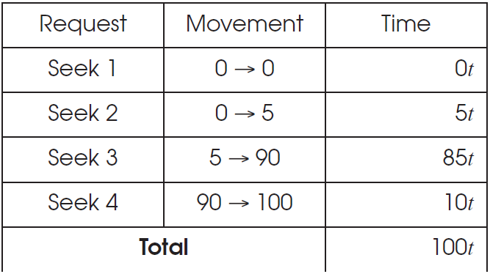
Disk Scheduling
First-come first-serve
Elevator Algorithm

Slide 37
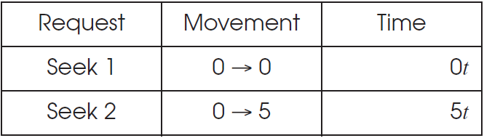
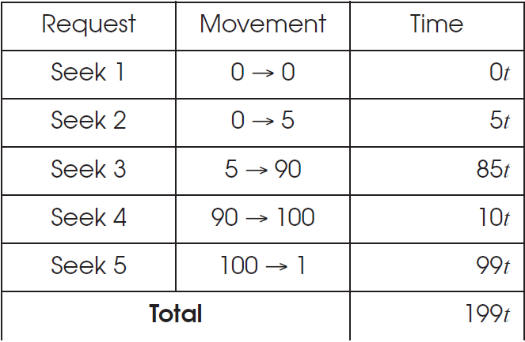
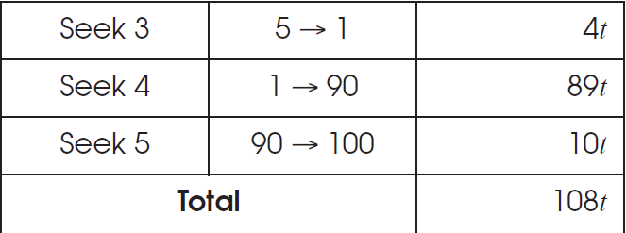
Disk Scheduling
Shortest-Seek-First
Elevator Algorithm

